Slide 1

OpenGL ES Projection and Camera Views Chapter 5
Eng. Basma Hassan
Eng. Samar Shaban

Slide 2
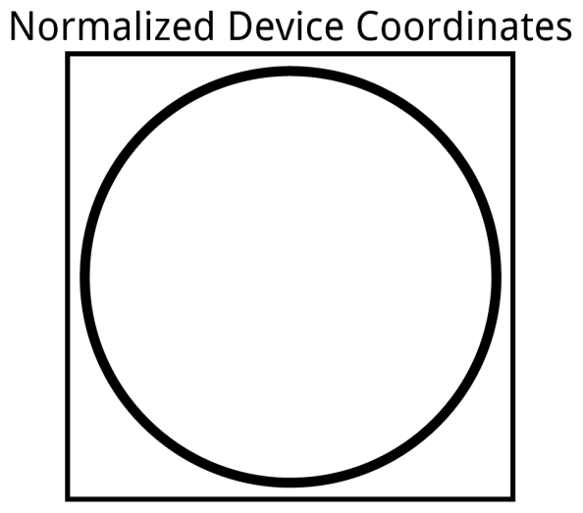
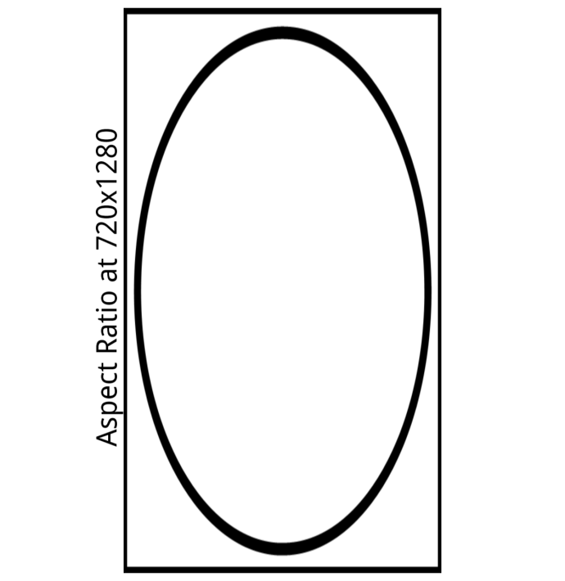
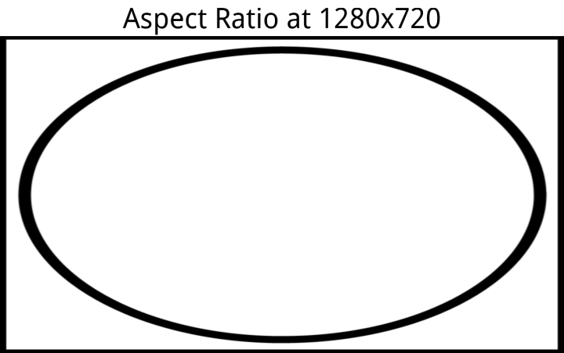
OpenGL Coordinates Problem
OpenGL uses normalized device coordinates
gets mapped to a range of [-1, 1] on both the x, y, and z-axes.
independent of the actual size or shape of the screen.
assumes that the coordinate space is a square.

Slide 3
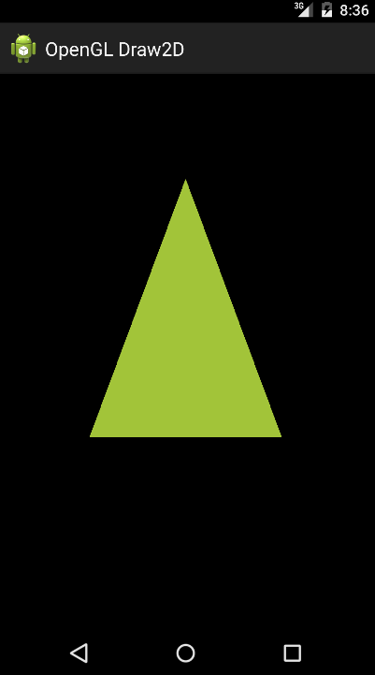
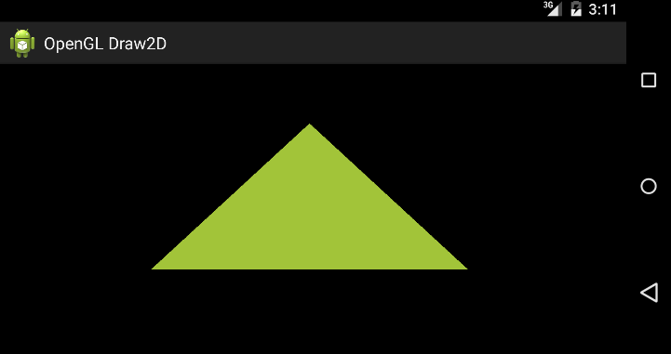
Previous Lab Problem….
Problem: Shape changes with screen orientation change.
Reason: The object’s vertices have not been corrected for the proportions (aspect ratio) of the screen area.
Solution: Projection and Camera View.
Landscape
Portrait
Notes:
The reason why this is happening is because we’ve been passing our coordinates into OpenGL directly, without
compensating for the aspect ratio of the screen.

Slide 4
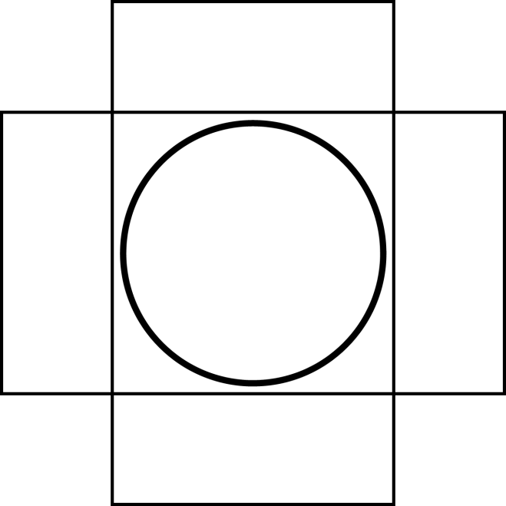
OpenGL Coordinates Solution
Adjust the OpenGL coordinate space so that it takes the screen shape into account.
How…
keep the smaller range fixed to [-1, 1], and
adjust the larger range in proportion to the screen dimensions.

Slide 5
Projection and Camera Views
Allow displaying objects more closely to how you see physical objects with your eyes.
Simulation done with mathematical transformations of drawn object coordinates.
Projection
This transformation adjusts the coordinates of drawn objects based on the width and height of the GLSurfaceView.
Calculated when the proportions of the OpenGL view are changed.
Camera View
This transformation adjusts the coordinates of drawn objects based on a virtual camera position.
Calculated only once when the OpenGL view is established.

Slide 6
Orthographic vs. Perspective Projection
Orthographic Projection:
Simply, it ignores the z-component of the point.
Good for engineering designs
Not realistic
Objects far from the eye aren’t appear smaller than objects close the eye.
Perspective Projection:
Things far from the eye look smaller.
Tries to model the viewing of the human eye:
A ray from the point to the eye is drawn, and its projection on the near plane is observed.
The projection on the near plane is what we see on the screen.

Slide 7
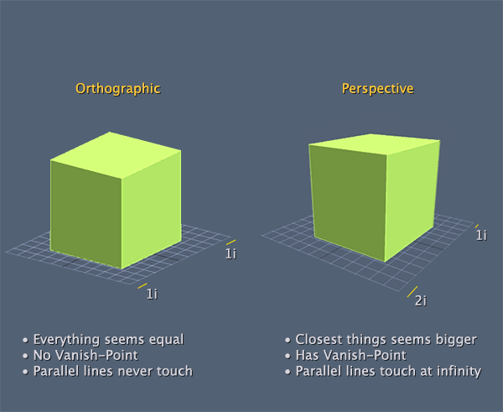
Orthographic vs. Perspective Projection

Slide 8
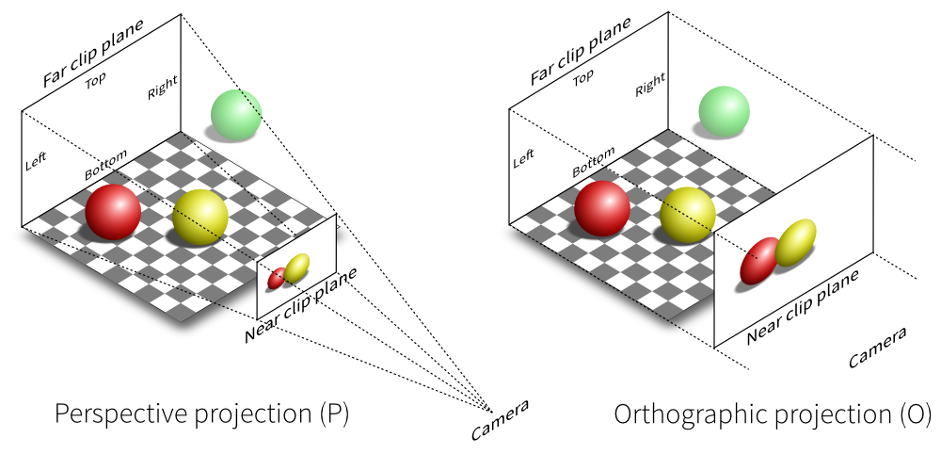
View Frustum
Youtube Video: https://www.youtube.com/watch?v=s4lPY44eh2c

Slide 9
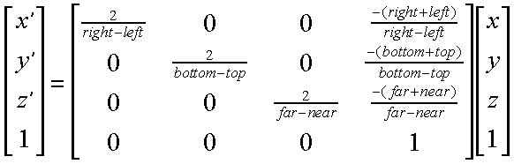
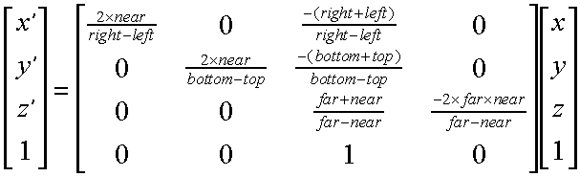
Projection Matrices
Orthographic →
← Perspective

Slide 10
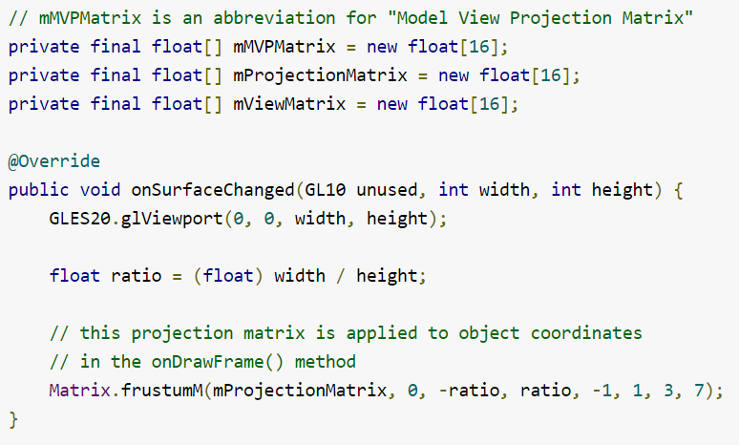
Define a Projection

Slide 11
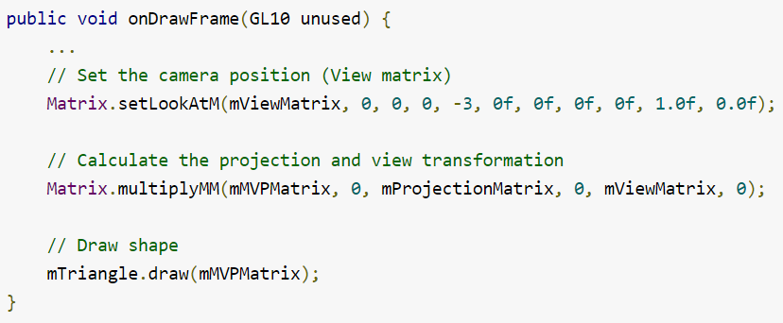
Define a Camera View

Slide 12
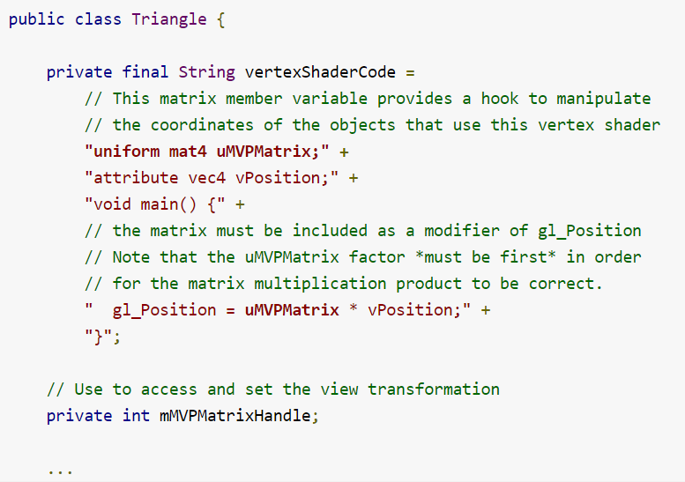
Apply Transformations

Slide 13
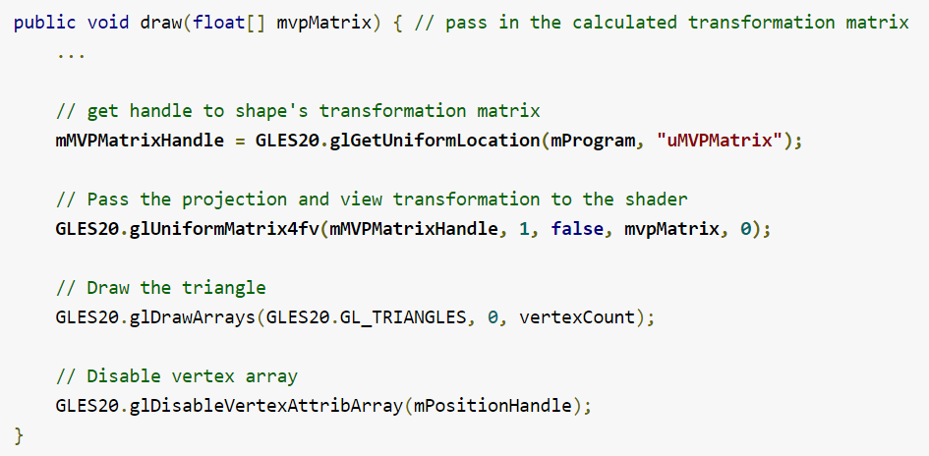
Apply Transformations (Cont.)
1
1

Slide 14
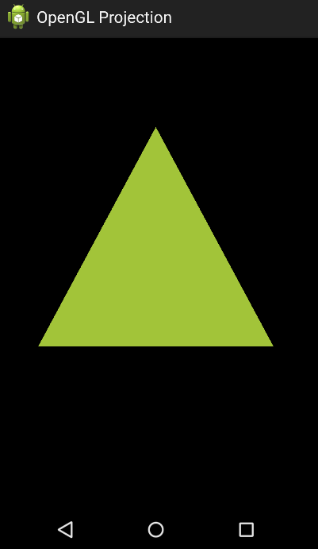
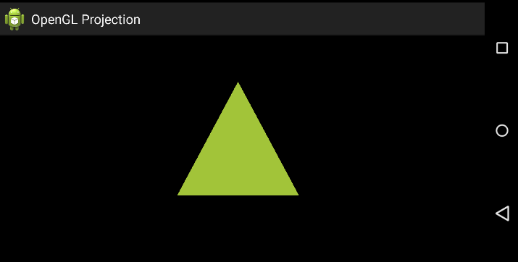
Final Output
Landscape
Portrait

Slide 15
Transformation
Translate, Scale, and Rotate

Slide 16
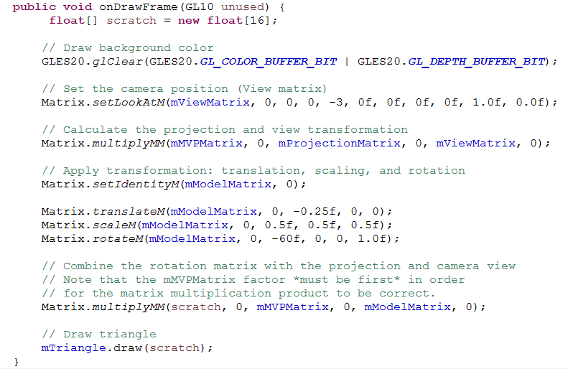
Applying Transformation

Slide 17

See you Next Lab

